Slide 1
UNIX File System

Slide 2
Introduction
One of the remarkable features of the UNIX operating system is the concept of files used in it.
In UNIX a file is any source from which data can be read and any destination to which the data can be written
ie, all input and output devices are treated as files in UNIX,

Slide 3
Filenames
Start filename with an alphabetic character
Use dividers to separate parts of the name
Use an extension at the end of filename
Never start a filename with a period

Slide 4
File Types
Regular file - contain user data
  Text Files
    Characters drawn from the computers character set
  Binary Files
    Collection of data stored in the internal format of the computer

Slide 5
Directory files, directory file contains the name of other files and/or directories (sub directory).
Directories have names just like other files, and these names obey the same naming rules as normal files.
A directory is used to store a record for each file or subdirectory it contains.
This record (also called directory entry) consists of the file inode number and the file name.

Slide 6
Root directory (/), at the top of the file system hierarchy and denote as a slash (/)
When you log on, the UNIX system puts you in a specific directory, called your home directory.
You can specify your home directory by using the tilde (~)
The directory you are in at any particular time is called Present Working Directory (pwd) Also called as current directory.
You can specify your working directory by using the (.) operator
Parent directory is immediately above the working directory.
You can specify your parent directory by using the (..) operator

Slide 7
Special files (devices), it is a mean of accessing hardware device, including the keyboard, hard disk, CD-ROM drive…etc.
Each hardware device is associated with at least one special file.
A command or an application accesses the special file in order to access the corresponding device.
There are two types: a character special file for a char oriented devices such as for keyboard and block special file for block oriented devices such as a disk.
Usually they reside in the /dev directory.

Slide 8
Symbolic Link files : a logical file that defines the location of another file somewhere else in the system
FIFO Files : file used for interprocess communication.
Socket : file that is used for network communication

Slide 9
Path & Pathnames
Absolute pathname specifies the full path from the root to the desired directory or file
Relative Pathname is the path from the working directory to the file.
When a relative pathname is used, UNIX starts searching from the working directory

Slide 10
File System Structure
The UNIX file system is structured hierarchically upside down treelike, so it start with root directory and can have any number of files or sub directories under it. A typical UNIX system contains hundreds of files and directories, organized as the following
root
bin
tmp
etc
user
sh
ps
passwd
Proj a
Proj b

Slide 11
Root directory (/), at the top of the file system hierarchy and denote as a slash (/), it is the master cabinet which contains all.
/bin - it is known as binary directory, it contains binary -executables- including cat, kill, mv, rm, echo, date, mkdir, ksh, pwd...etc.
/dev - it is the device directory, contains files corresponding to the devices (terminals, disk drives..) connected to the computer. These are the special files mentioned earlier. Some files like lp (line printer), hd (hard drive), tty (terminal) are example of these files.
/etc - contains commands and files for system administration. A typical user not allowed to use these files and commands. Files in this directory include login, passwd, and profile.

Slide 12
/lib - contains a collection of related files for a given language in a single file called an archive. A typical UNIX system contains libraries for C, C++ and other languages. The archive file is used by application developed by that language. Some libraries are also stored in /usr/lib directory.
/lost+found - it contains all the files not connected to any directory. These files are found by a UNIX tool, fsck (file system check).
/tmp - it contains temporary files, all files are deleted periodically so the disk does not get filled with temp files.
/home - home directories for all users to store their personal files
/home/student

Slide 13
/usr - it may hold some directories which contains the UNIX utilities, tools, languages, libraries, and manual pages. Two of the most important sub directories in this directory are /bin and /lib.
/var - it contains log files(/var/log), emails(/var/mail), print queues(/var/spool)

Slide 14
File System implementation
In the original Unix file system, Unix divided physical disks into logical disks called partitions
Each partition is a standalone file system. We will use the term ``file system'' when referring to a single partition.

Slide 15
Each file system has four structural sections:
Boot block - located in the first few sectors of a file system. The boot block contains the initial bootstrap program used to load the operating system.
Super block - contains information about the file system: the total size of the partition, the block size, pointers to a list of free blocks, the inode number of the root directory etc.
Inode block - contains the information about each file in the data block .
The file information is stored in records known as inodes
There is one inode for each file on the disk
Data blocks - blocks containing the actual contents of files

Slide 16
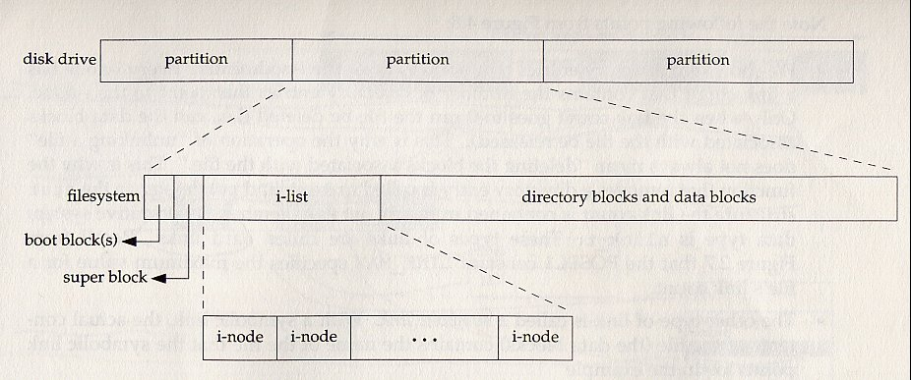
Disk File Format

Slide 17
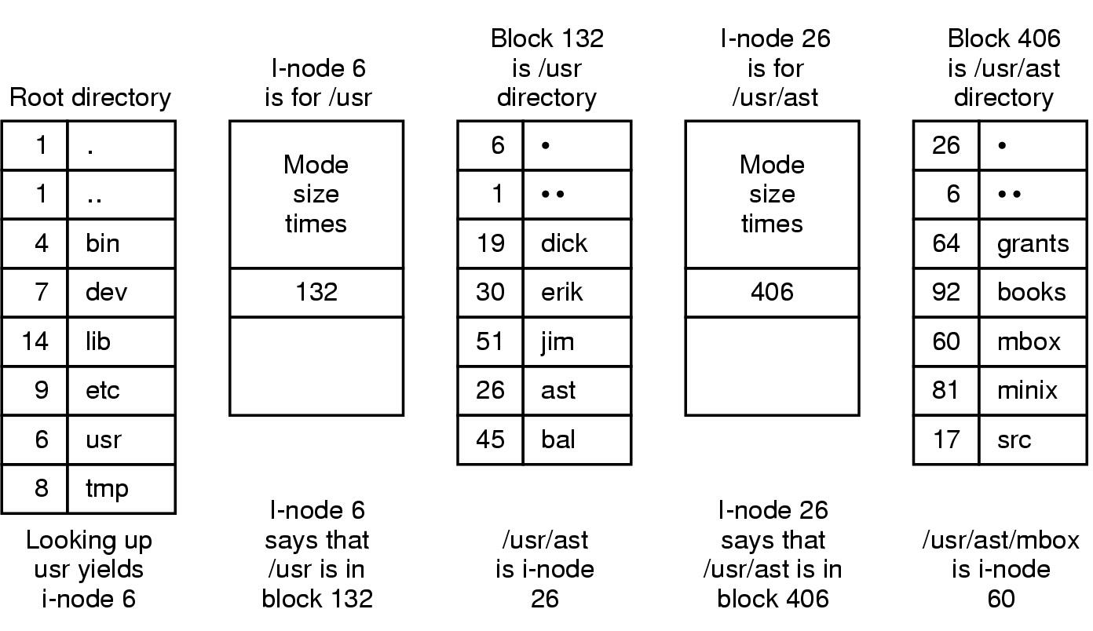
The steps in looking up /usr/ast/mbox

